Slide 1
All About Me
By Treyyyyyyyyyyyyyyyyyyyyyyyyyyyyyyyyyyyyyykkkkkkkkkkkkkkkkkkkkkkk

Slide 2
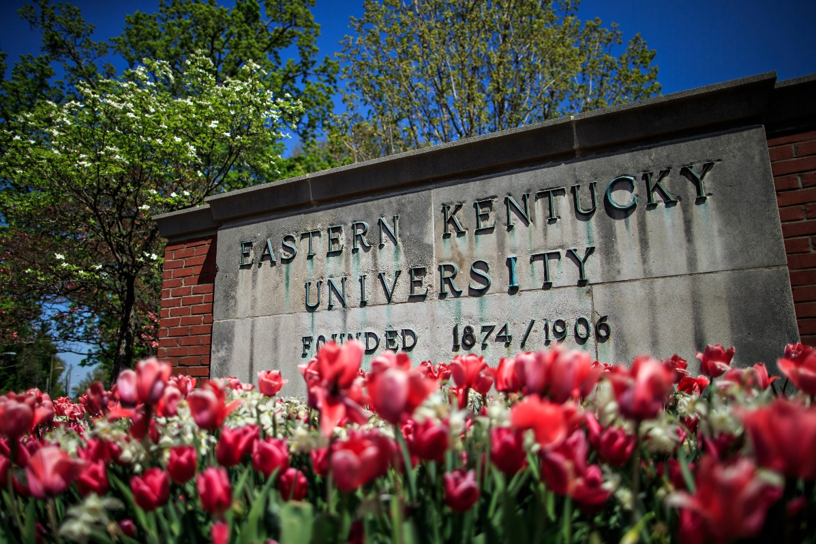
WHERE I LIKE TO VISIT
A place I like to visit is the
University Kentucky

Slide 3
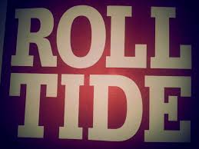
FAVORITE TEAM
My favorite team is ALABAMA ROLL TIDE!!!!!!!!

Slide 4

FAVORITE SUBJECT
My favorite subject is MATH

Slide 5

My Favorite Color

Slide 6

Favorite NFL Team
My Favorite NFL team is the Carolina Panthers

Slide 7
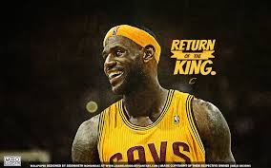
FAVORITE BASKETBALL PLAYER
My Favorite Basketball Player is Lebron James

Slide 8

A SPORT I PLAY
A sport I play is baseball

Slide 9

My Favorite Tv Show
My favorite Tv show is EPSN

Slide 10

My Favorite Movie
My Favorite movie is Baby Boy

Slide 11
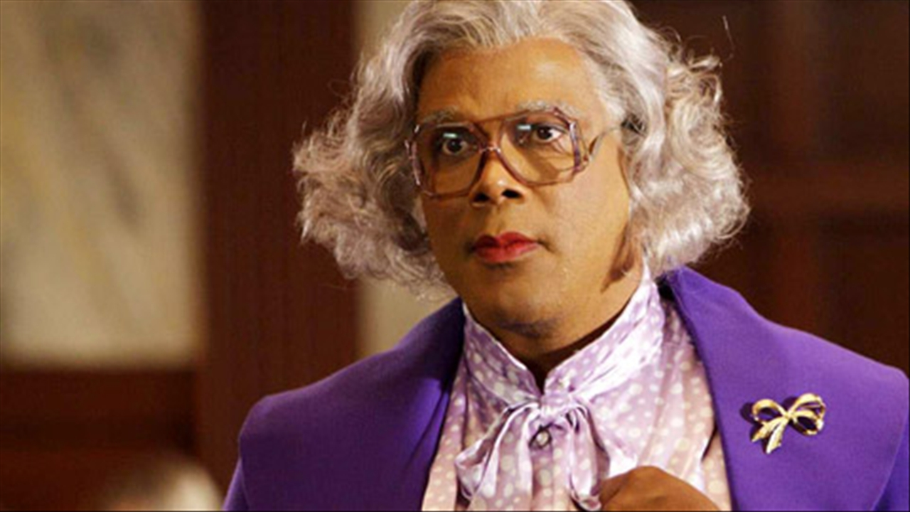
My Favorite Actor
My favorite actor is Tyler Perry

Slide 12
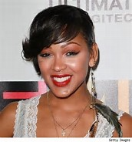
My Favorite Actress
My favorite actress is Meagan Good she one of the finest actress

Slide 13

My Favorite Rapper
My favorite rapper
Is Daye

Slide 14

My Favorite Album
This my favorite album Because all the songs on there GOING OFF!!!!!

Slide 15
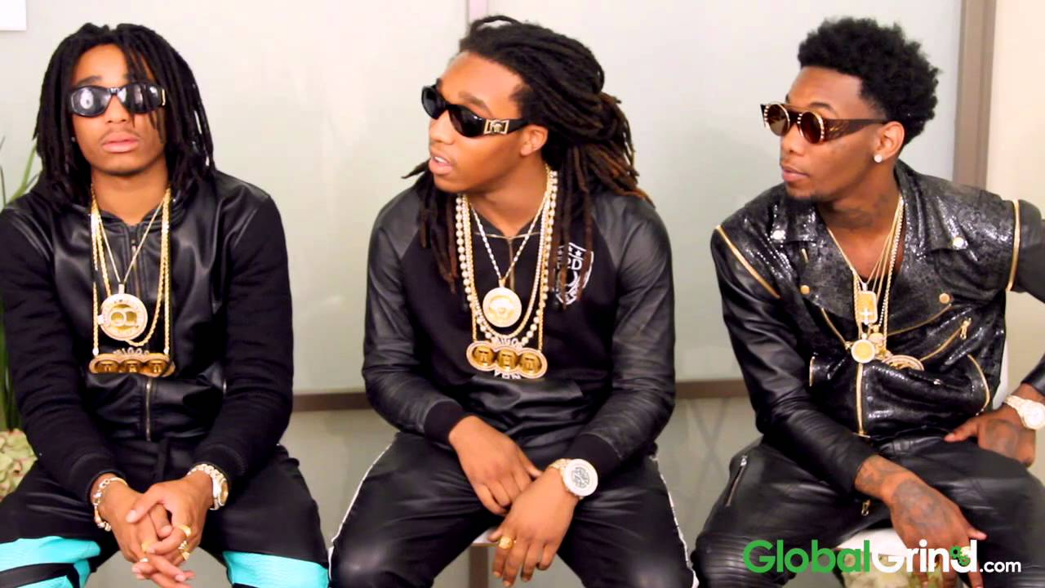
My Favorite Group
This my favorite Rap Group because in all of there songs they all keeping it #100

Slide 16
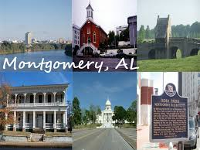
Where I Grew Up
This where I grew up in if u wanted to know y umm bad go to stay down there for 5years and come back you will see y umm like this

Slide 17
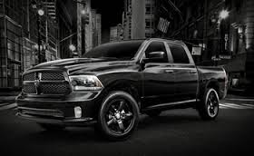
My Favorite Truck
My favorite truck is a dodge ram

Slide 18
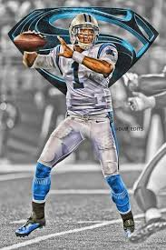
My Favorite Football Player
Cam Newton is my favorite player is because is the best quarterback in the NFL

Slide 19
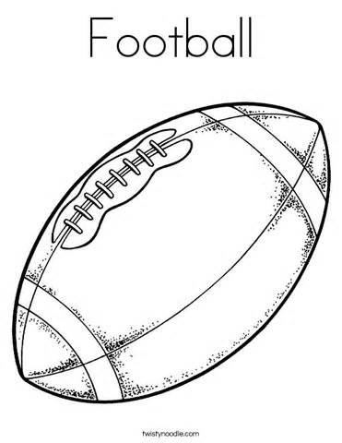
My Favorite Sport
My favorite sport is football

Slide 20

THE END

