Slide 1
All about me
By Treyy

Slide 2

My Favorite Color

Slide 3

My Favorite Tv Show

Slide 4

My Favorite Movie

Slide 5
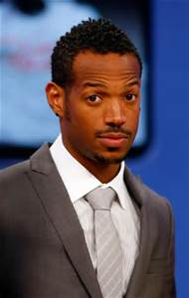
My Favorite Actor

Slide 6
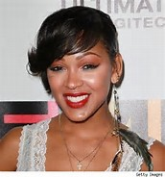
My Favorite Actress

Slide 7

My Favorite Rapper

Slide 8

My Favorite Album

Slide 9

My Favorite Group

Slide 10

My Favorite Sport

